Slide 1
WELCOME TO OUR
PRESENTATION
1

Slide 2


<TEAM INITIATORS>
TEAM
MEMBERS
Bibi Aysha Raha
Murshida Akter
221-15-4709
221-15-4703
2

Slide 3
Formalin Detection in Pineapple
TABLE OF CONTENT
01
INTRODUCTION
02
MOTIVES AND OVERVIEW
03
METHODOLOGY / WORKING FLOW
04
FUTURE SCOPE
05
MERITS AND DEMERITS
3

Slide 4

RESEARCH
TITLE
Formalin Detection in Pineapple
4

Slide 5
INTRODUCTION
Formalin, a potentially harmful preservative which is sometimes illegally used to extend the shelf life of fruits. Detecting its presence or absence is essential to safeguard consumers and uphold food safety standards.
Formalin detection in pineapple research signifies a commitment to food safety, consumer protection, and regulatory compliance. It paves the way for the implementation of quality control measures within the pineapple industry, fostering trust among consumers and stakeholders.
Develop a model to accurately detect formalin in pineapple.
Implement and fine-tune NLP algorithms to capture subtle condition of pineapple.
Create a user-friendly interface to visualize and interpret formalin detection results.
MOTIVE
OF THIS RESEARCH
5

Slide 6
RESEARCH
OVERVIEW
Chemical Analysis
Spectroscopy
Immunoassays
Sensor Based Methods
Microscopic Techniques
Molecular Testing
Data Collection
Image Preprocessing
Annotation and Labelling
Feature Extraction
Model Training
Model Evaluation
Model Deployment
Model Monitoring and Testing
Iterative Improvement
Integration with Systems
Validation and Field Testing
RESEARCH
METHODOLOGY
6

Slide 7

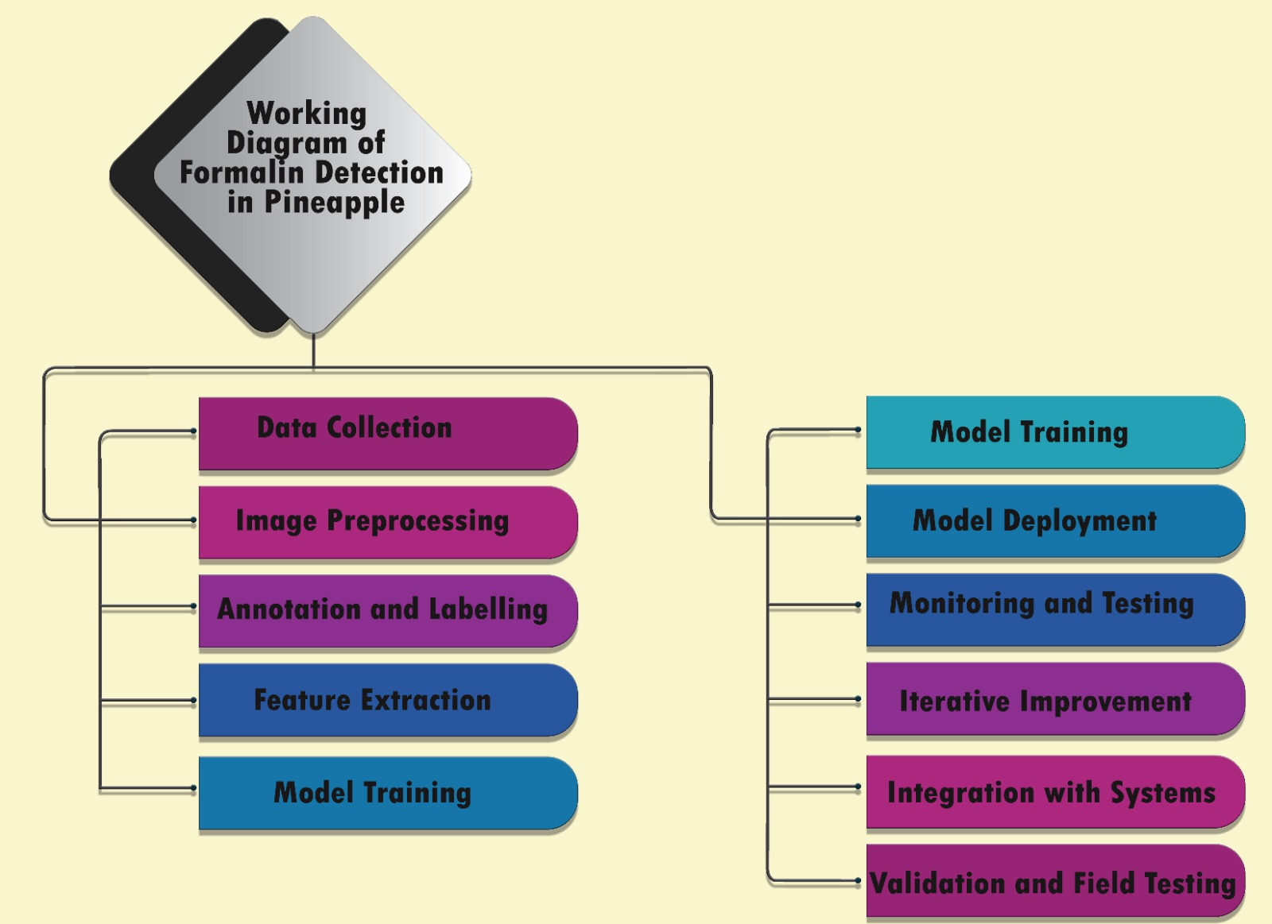
RESEARCH
DIAGRAM
Nano Technology
Miniaturization
Smart sensors
High Throughput Screening
Multiplex Detection
Biosensors
Advanced Spectroscopy Techniques
Data Analysis
Remote Sensing Technologies
Educational Campaigns
13

Slide 8
IMPROVED SENSING TECHNOLOGY
ENHANCED ACCURACY AND SPEED
NOVEL DETECTION APPROACHES
INTERDISCIPLINARY RESEARCH
ENVIRONMENTAL MONITORING
PUBLIC AWARENESS EDUCATION
Nano Technology
Miniaturization
Smart sensors
FUTURE SCOPE
High Throughput Screening
Multiplex Detection
Biosensors
Advanced Spectroscopy Techniques
Data Analysis
Remote Sensing Technologies
Educational Campaigns
13

Slide 9
MERITS
OF THIS RESEARCH
Health Protection
Ensuring Food Safety
Quality Assurance
Enhancing Consumer Confidence
Regulatory Compliance and Integrity
Advancement of Food Testing Technology
Cost
Time-Consuming
Complexity
Sample Size
False Positives or Negatives
DEMERITS
OF THIS RESEARCH
14

Slide 10
THANKS
15

